Slide 1


Analysis of Tesco Data
Notes:
Hello, this is a presentation of a case study produced around data from Tesco

Slide 2

Introduction
Tesco is one of the largest supermarket chains in the UK
Data was collected from 420M food product purchases by 1.6M loyalty card users in 2015
This data was used to perform analysis on correlation of nutrients with:
Obesity
Type-2 Diabetes
Average weekly income
Notes:
Tesco is one of the largest supermarket chains in the UK, with 2,895 stores in the UK
The Tesco Data used in this study was collected from 420M food products purchased by 1.6M loyalty card owners from 411 tesco stores in the Greater London area in the year 2015
This was used to perform analysis on correlation of nutrients with:
Obesity
Type-2 Diabetes
Average weekly income

Slide 3
The datasets used in this study
The average nutrient content of food products bought in different Greater London boroughs and wards in 2015
Obesity in boroughs 2012
Type-2 diabetes estimates in wards 2016
Average weekly income in boroughs 2002-2022
Notes:
Multiple datasets where used in this study
Firstly, the Tesco food product dataset from 2015 contained a lot of data about the food products that were bought by the loyalty card owners, this data included average weights, volume and energy in kcal of food and drink products purchased and their nutritional data such as avrg weight, volume and energy of protein, carbohydrates, sugar and other nutrients. This data was split into data collected from different area levels in the greater London area, these area levels are boroughs, Wards, Middle Layer Super Output Area (MSOA) and Lower Layer Super Output Area (LSAO) which are respective of the size of the area from largest to smallest.
In this study, the focus from this dataset was set on the average weights of different nutrients contained in food products in London boroughs and wards
The second dataset that was in the study, contained data gathered around the how many people are considered obese, overweight and healthy weight in Lodon Boroughs in 2012 but this study focused on the ratio of obesity
The third dataset contained estimates of how many people had type-2 diabeted in London wards in 2016
And the last dataset was imported online and contained the average weekly income of individuals in London boroughs from 2002 till 2022

Slide 4

The nutrients focused on
Protein
Carbohydrates
Fibre
Fat
Saturated fats
Sugar
Salt
Notes:
The nutrients that were focused on in this study were, protein, carbohydrates, fibre, fat, saturated fat, sugar and salt.

Slide 5

Average Nutrient Weights
In the average nutrient weights in grams given in the food product dataset
$$\text{Weigh}t_{nutr_{i}}\text{(}\text{a}\text{) = }\frac{\sum_{p∈P_{a}}{grams\left(nutrient_{i}\left(p\right)\right)}}{\left|P_{a}\right|}$$
Where P_{a} is the set of all food products purchased by the residents of area a, and p is one of such products.
Notes:
In the food product dataset, the average weights of nutrients in products in grams which is basically the mean weight of nutrient i in all products purchased in area a can be calculated as seen in the equation.

Slide 6


Obesity
The Body Mass Index (BMI) is a measure of whether a person is of healthy weight for their height
$$BMI= \frac{weight (in kg)}{{height}^{2} (in meters)}$$
If a person’s BMI is:
18.5 < BMI < 25: Healthy range
25 < BMI < 30: Overweight
BMI > 30: Obese
Notes:
The Body Mass Index is a measure of whether a person is of healthy weight to their height. It can be calculated by dividing the weight of the person in kg by their height in meters squared.
If the BMI falls within 18.5 and 25, the person is of healthy weight.
If it falls between 25 and 30, theyre overweight
And if it greater than 30, they are obese.

Slide 7


Obesity
The obesity was given as the prevalence of obese people in the population
$$Prevalence\left(a\right)= \frac{Number(a)}{P_{a}}$$
Where $P_{a}$ is the Population
Notes:
In our obesity dataset, the prevalence of people with obesity in area A what given as the number of people with obesity in area A over the population of people in area a.

Slide 8
Correlation
Correlation is the measure of how two values relate to each other
The correlation coefficient is a value between -1 and +1
A correlation coefficient of +1 suggest a positive linear relationship
Meanwhile -1 suggest an inverse linear relationship
Notes:
Correlation is a measure of how two values relate to each other. For us to understand this, we calculate the correlation coef.
This coef can take a value between -1 and +1
A value of +1 tells us that the two values have a positive linear relationship
While a value of -1 tells is that they have an inverse linear relationship

Slide 9
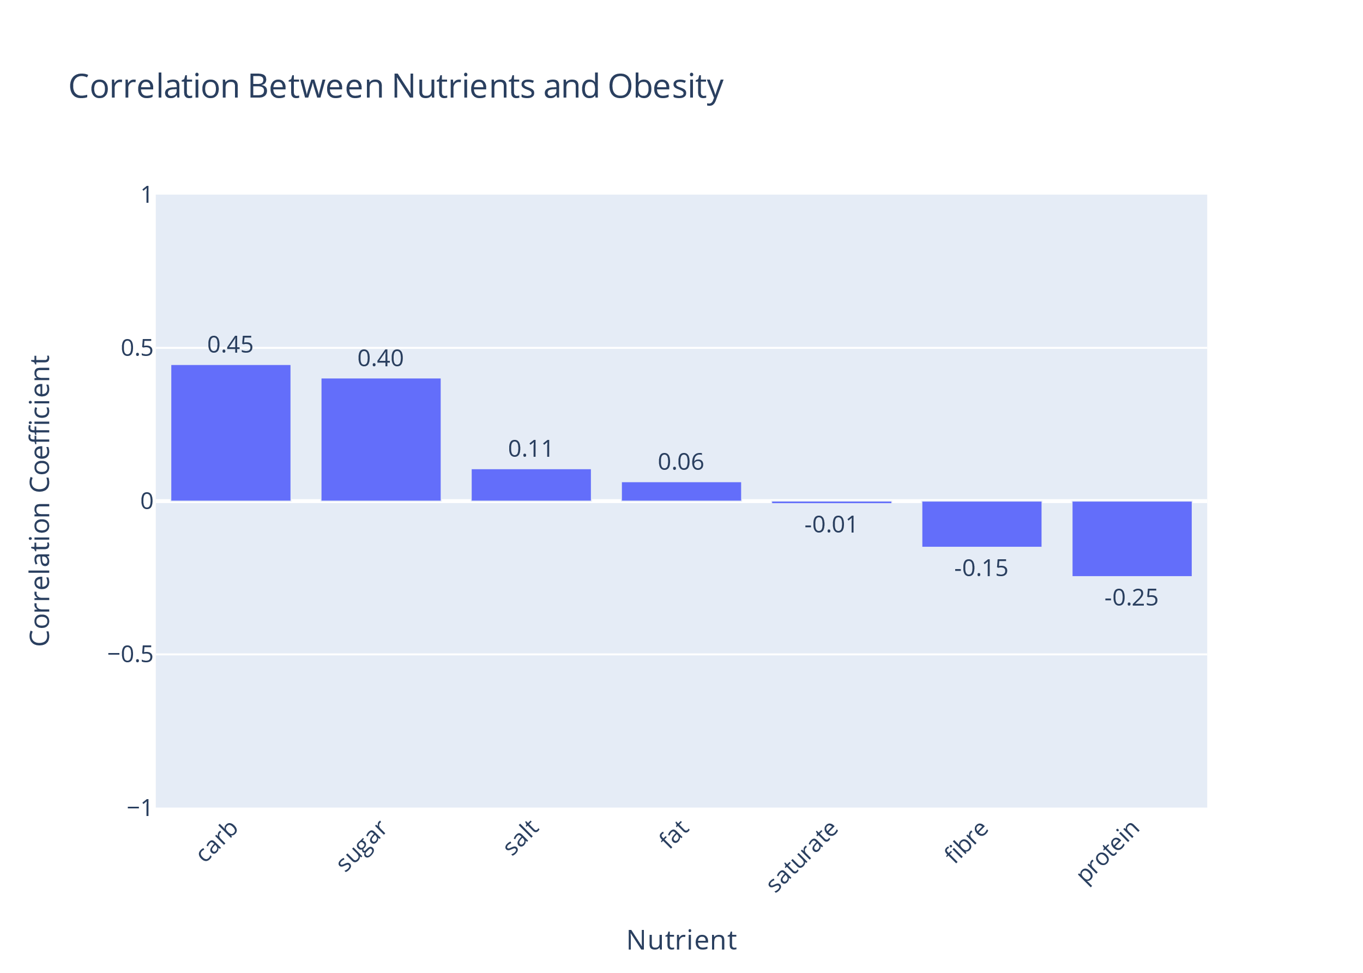
Nutrients and Obesity Correlation
The obesity dataset was from 2012 while nutrients was 2015
Assumption: the variables under investigation exhibit stable relationships over time
Notes:
The correlation coef between the diff nutrient weights in diff London boroughs and obesity pervalence was found under the assumption that the variables exibit a stable relationship over time as the two datasets are of diff years.
It was found that carbohydrates and sugar affect obesity the most with 0.45 and 0.4 corr coef respectively with carbs affecting the most
It can also be seen that protein and fibre had a negative affect on obesity with -0.15 and -0.25 coefs respectively.
It can be seen that salt and fat increase obesity, but their coefficients are on the lower side. It can also be stated that saturated fats seem to not have an affect on obesity as the coef value can be assumed negligible.

Slide 10
Type-2 diabetes
Type-2 diabetes is a common long-term disease that causes the level of sugar in the blood to become too high [2]
Just as obesity, it was given to us as the prevalence of the estimate of people with this disease
Notes:
Type-2 diabetes is a common long-term disease that causes the level of sugar in the blood to become too high, causing many risks for the people with this disease,
In our diabtes estimate dataset, just as obesity, we got the prevalence of people w diabetes in a given WARD this time not a borough

Slide 11
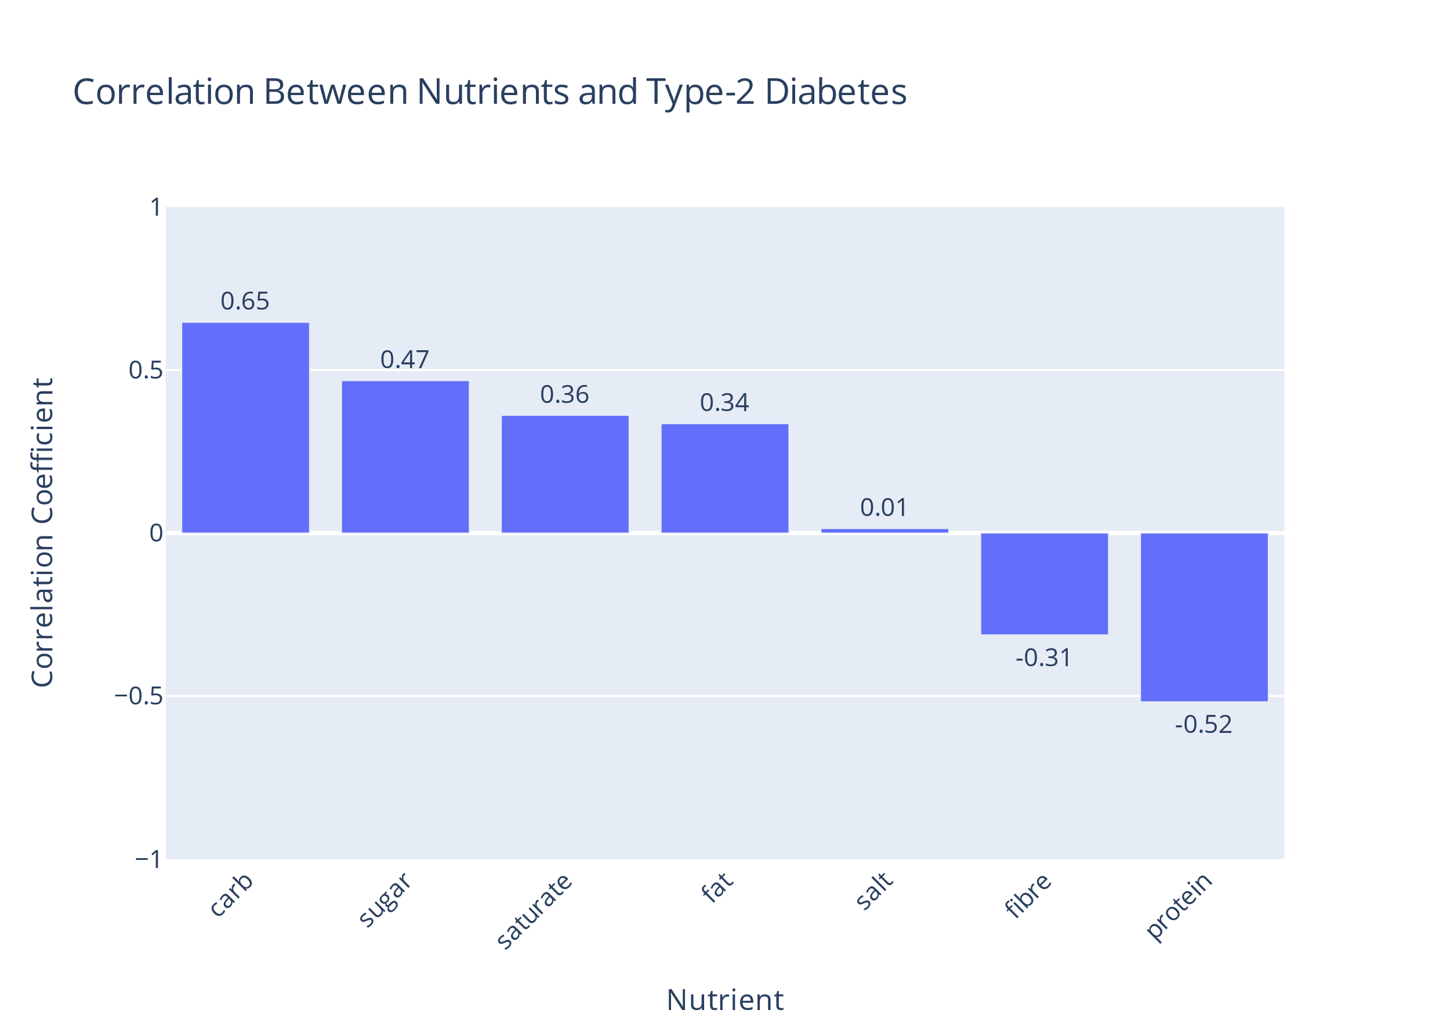
Nutrients and Type-2 Diabetes Correlation
The Type-2 diabetes estimates dataset was from 2016 while nutrients was 2015
Assumption: the variables under investigation exhibit stable relationships over time
Notes:
The correlation coef between the diff nutrient weights in diff London Wards and type-2 diabetes pervalence was found under the assumption that the variables exibit a stable relationship over time as the two datasets are from diff years.
It was found that carbohydrates and sugar affect obesity the most with 0.65 and 0.47 corr coef respectively with carbs affecting the most
Then saturated fats and fats are the 3rd and 4th most affective with 0.36 and 0.34 corr coef
It can also be seen that protein and fibre had a negative affect on obesity with -0.31 and -0.52 coefs respectively.
It can also be stated salt seems to not have an affect on diabetes as the coef value can be assumed negligible.
So again as in obesity, fibre and protein are seen to be considered on the healthier side of nutrients meanwhile sugar and carbohydrates are the opposite.

Slide 12

Average Weekly Income
An average weekly income dataset was imported from the office of national statistics [1]
Included the average weekly income taxes and benefits of decile groups of all households in London boroughs from the years 2002 up until 2022
Notes:
An average weekly income dataset was imported from the office of national statistics
It Included the average weekly income taxes and benefits of decile groups of all households in London boroughs from the years 2002 up until 2022

Slide 13
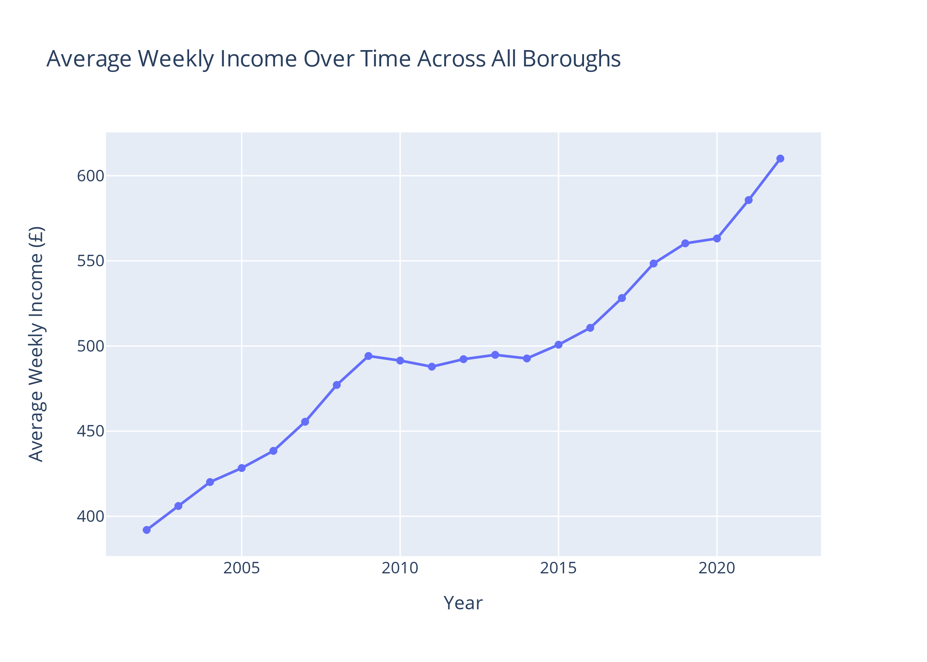
Average Income Across London Boroughs Over Time
Notes:
Plotting the average weekly income across all the boroughs, we could see that it increased from 391 pounds in 2002 to 610 pounds in 2022.
It can be seen that the income increase from 2002 up until 2009 then a plataue can be seen between 2009 and 2015.
After 2015, the income started increasing again, but flattened between 2019 and 2020 due to covid-19. Then it increase again from 2020 till 2022.

Slide 14
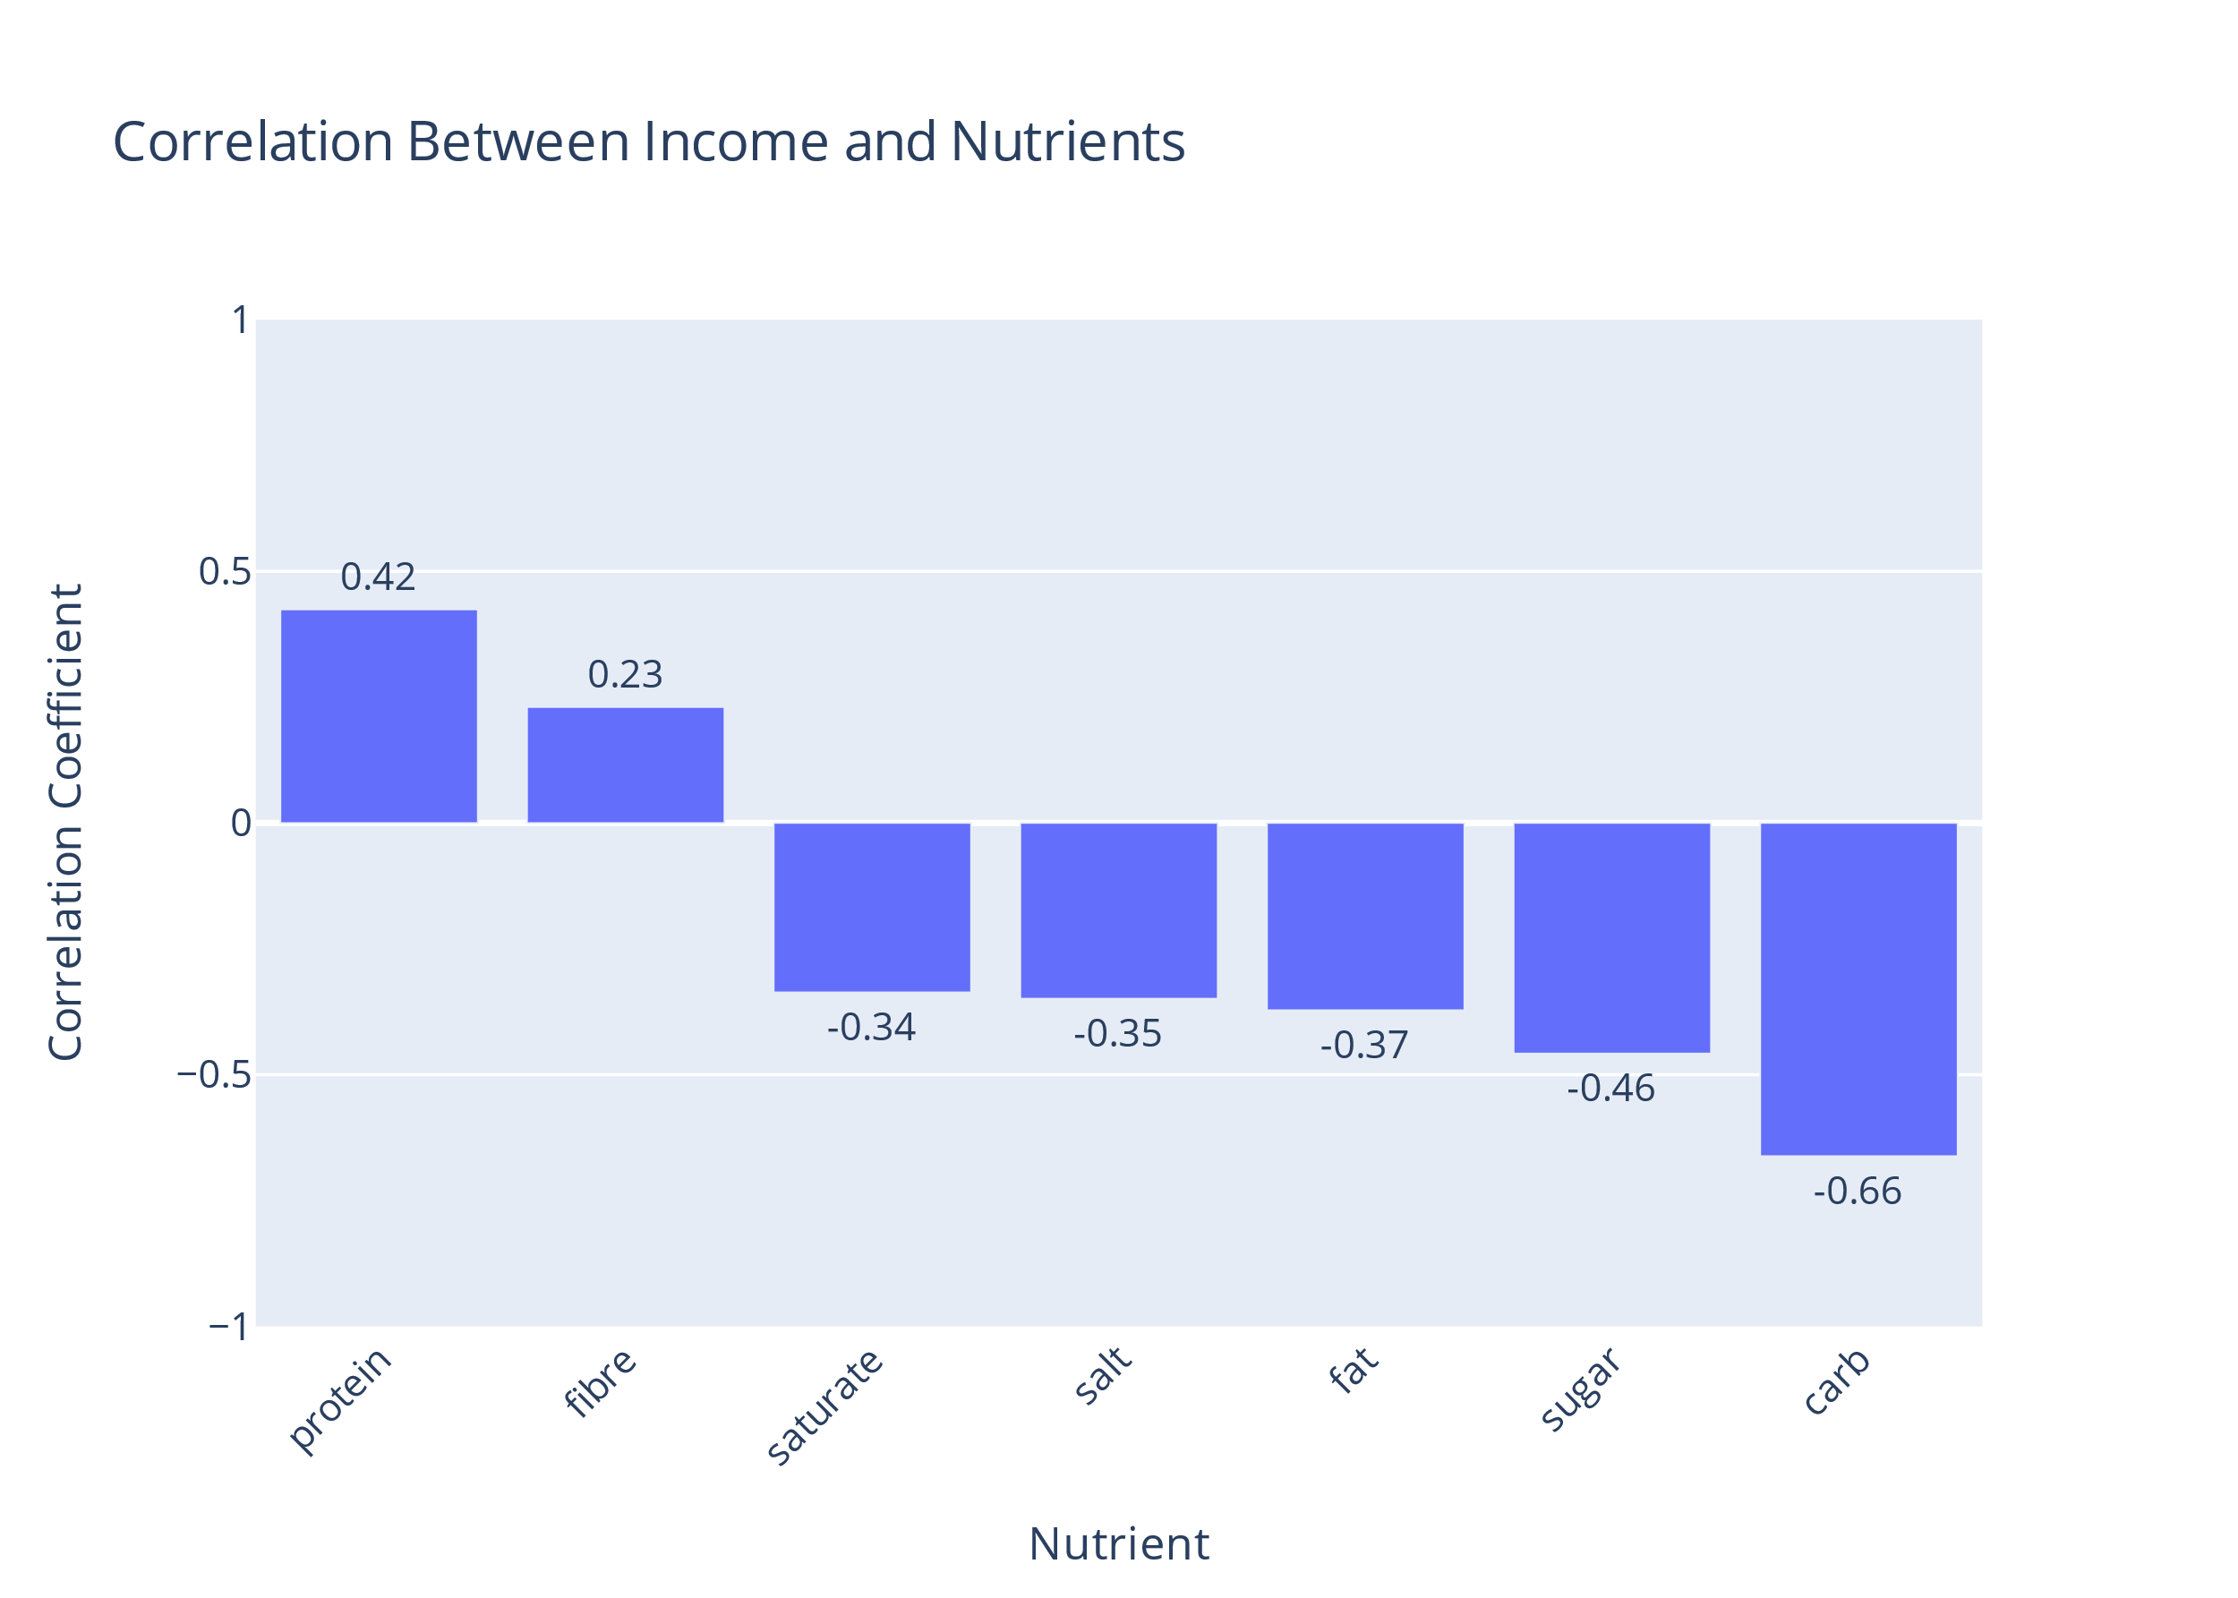
Nutrient and Income Correlation
Using the average weekly income across boroughs in 2015
Correlation coefficients were found between income and nutrients
Notes:
The correlation coef between the avrg income and nutrients was found in the years 2015.
Protein and fibre have the highest corr with the avrg income, meaning that people with higher incomes seemed to be buying products rich in these nutrs.
The rest of the products exhibit a negative corr with oncome with carbohydrates having the lowest at -0.66. This makes sense as foods rich in carbohydrates are usually on the cheaper side meaning that people with lower incomes would buy larger quantities of these foods.

Slide 15
Linear Regression Model
A linear regression model was trained on the 2015 datasets to identify how the nutrient weights would change over time according to the change of the weekly income
This model was validated with a 80/20 train-validate split
Mean square error was found to be 0.061
So proceeded to train on the entire dataset
Notes:
A linear regression model was trained on the 2015 datasets to identify how the nutrient weights would change over time according to the change of the weekly income
This model was validated with a 80/20 train-validate split
The Mean square error calculated and found to be 0.061, due to its low value, we proceeded to train the model on the entire dataset and create a forecast of how average nutrient weights in different years.

Slide 16
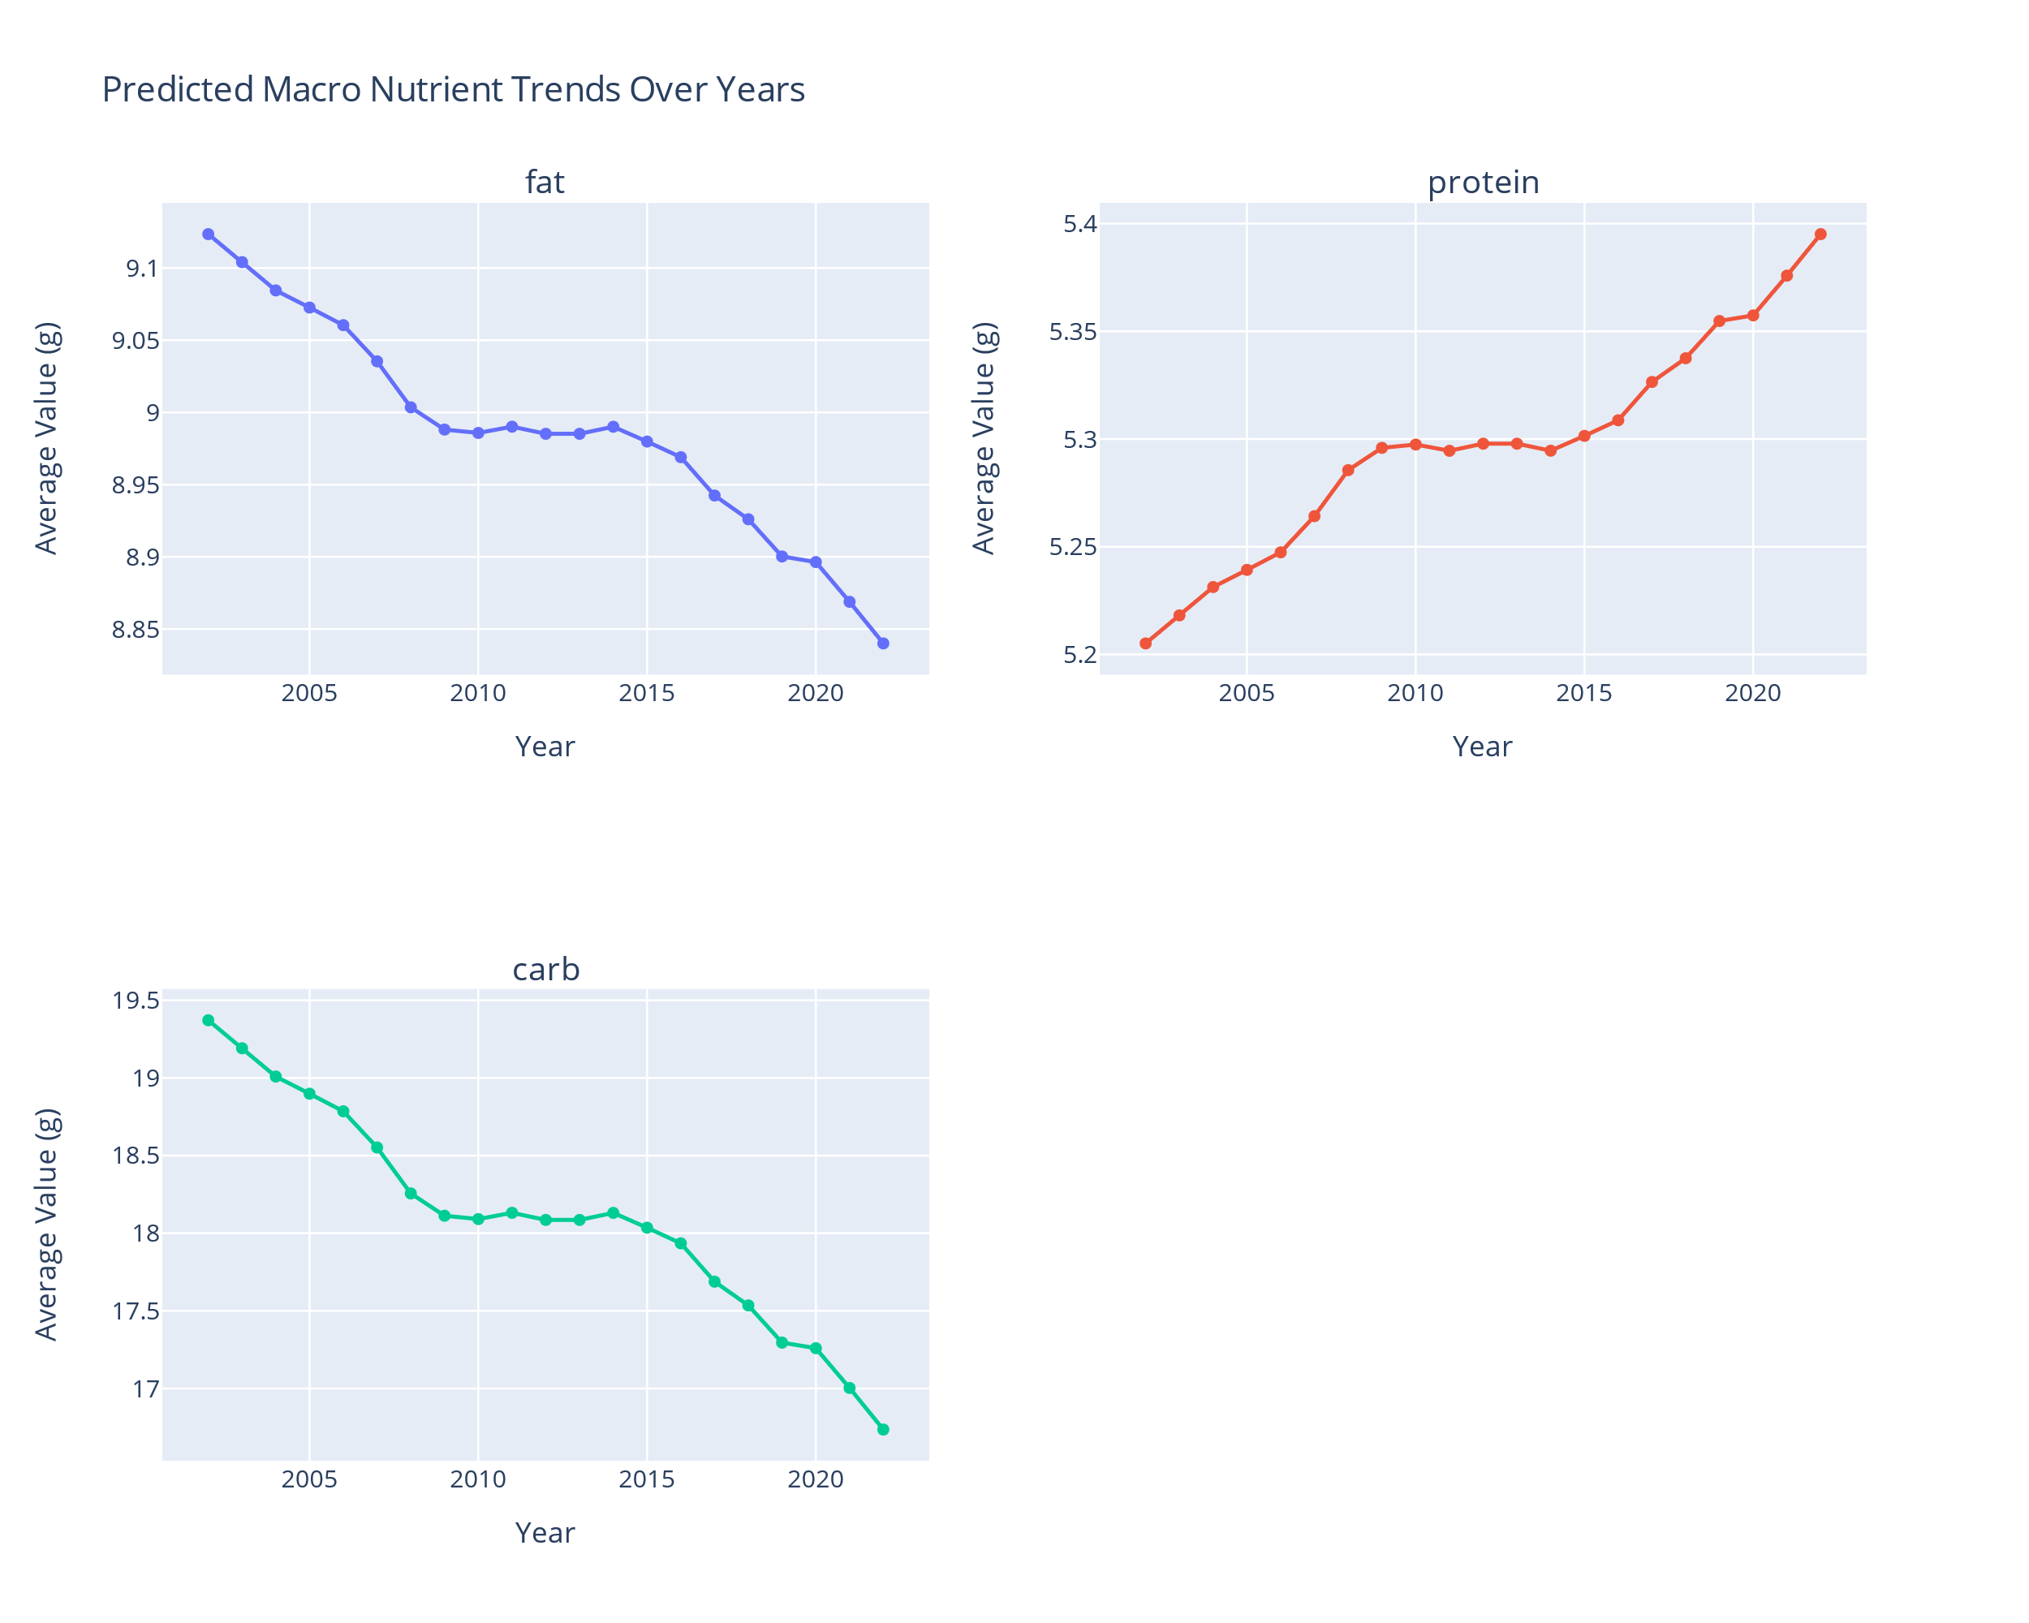
Macro-Nutrient Trends Over Time

Slide 17
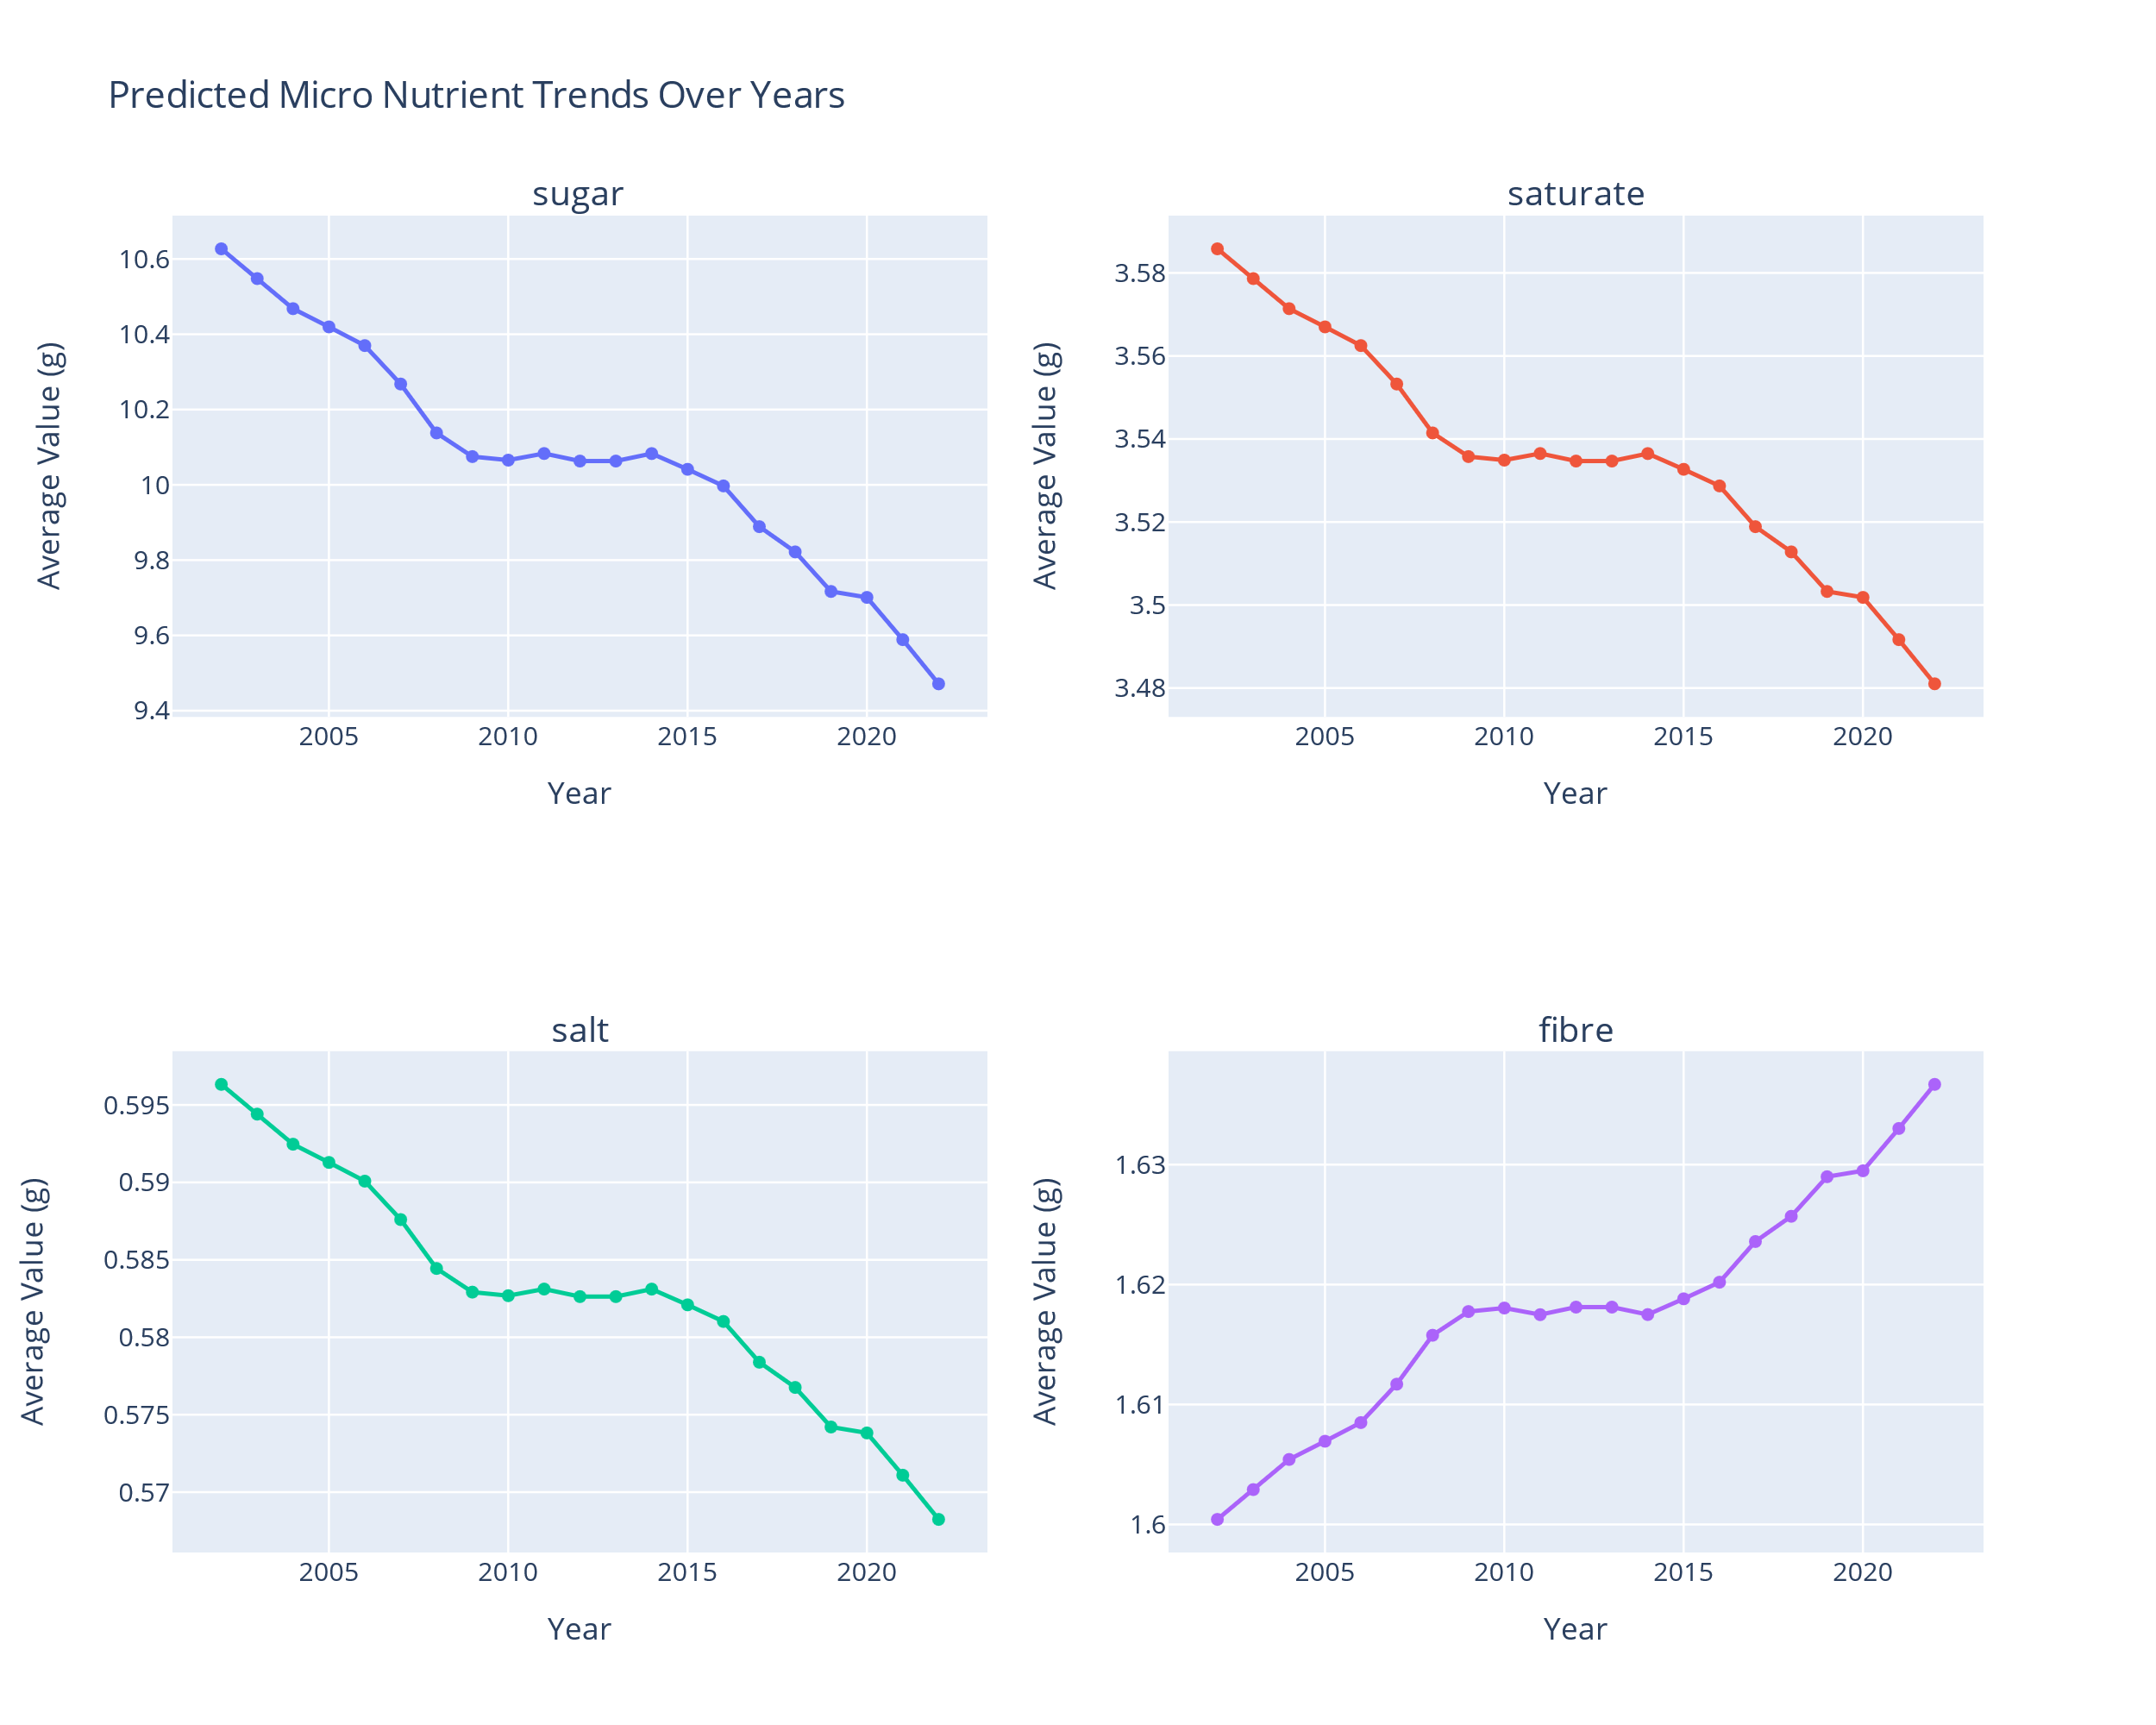
Micro- Nutrient Trends Over Time

Slide 18
Summary
Protein and fibre are the least affecting nutrients in obesity and type-2 diabetes
Carbohydrates and sugar are the most affecting nutrients in obesity and type-2 diabetes
Income increased over the years 2002 till 2022
As people income increases, they start eating healthier i.e. more protein and fibre in their food [3]

Slide 19
Bibliography
[1] (2023) annual survey of hours and earnings - resident analysis – Nomis, Office of National Statistics. Available at: https://www.nomisweb.co.uk/query/construct/summary.asp?mode=construct&version=0&dataset=30
[2] (2023) NHS. Available at: https://www.nhs.uk/conditions/type-2-diabetes/
[3] Rao, M. et al. (2013) Do healthier foods and diet patterns cost more than less healthy options? A systematic review and meta-analysis, BMJ open. Available at: https://www.ncbi.nlm.nih.gov/pmc/articles/PMC3855594/

